Slide 1

Programming in Python: iteration
Lesson 5: Searching using for loops

Slide 2
Objectives
In this lesson, you will learn how to:
use for loops to search for values in a list
design and write programs in Python that can search for values in a list
nest selection within a for loop.

Slide 3
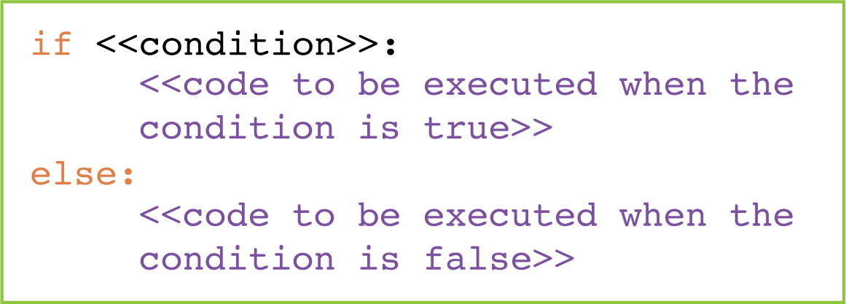
if statements
The if statement can make a decision about what to do next based on the outcome of a condition.
The condition must be a question that returns a True or False value.
It is important to understand the structure of an if statement.
An if statement must end with a colon.
The lines of code telling the computer what to do if the condition in the if statement returns True must follow the if statement and be indented.

Slide 4

Activity 5.1: Programming in Python: iteration, Section 5

Slide 5
Question 1
This program tells the user the index value of Orange.
Complete it by filling in the gaps.
fruits = ['Damson', 'Pear', 'Orange', 'Apple', 'Kiwi']
for i in range(0, ____________________):
if ____________ ____ 'Orange':
print('Orange is found at index value ', ____)
len(fruits)
fruits[i]
==
i

Slide 6
Question 2
This program tells the user if a number is Found or Not found in a list.
Complete it by filling in the gaps.
int
search = ______(input('Enter a number: '))
numbers = [3, 5, 7, 11, 12, 17]
found __ __________
for i in range(__, __________________):
if ________________ ____ ____________:
found = True
if found ____ ________:
print('Found')
else:
print('Not found')
=
false
0
len(numbers)
numbers[i]
==
search
==
True

Slide 7
Quiz 5

